Slide 1
Continental and global datasets for GIS
A short-list of some resources that I like by Ruth Kelly
Trinity College Dublin
15-11-2016

Slide 2
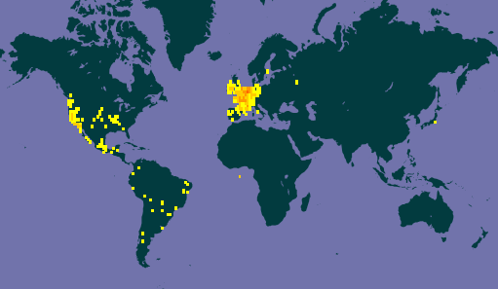
Species datasets
Species Occurrences
Global
www.gbif.org
Ireland – National Biodiversity Data Centre
http://www.biodiversityireland.ie/
UK – NBN gateway
https://data.nbn.org.uk/
Range maps
IUCN – 76,000 species
http://www.iucnredlist.org/technical-documents/spatial-data
BIEN – Botanical Information and Ecology Network
http://bien.nceas.ucsb.edu/bien/biendata/bien-3/
Example: Species data Lemna minuta from GBIF

Slide 3
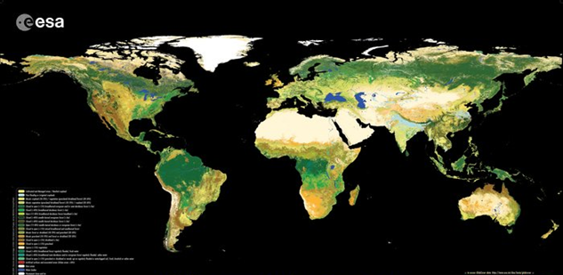
Land use and vegetation
CORINE land cover classification maps for Europe
http://www.eea.europa.eu/publications/COR0-landcover
Globcover
http://due.esrin.esa.int/page_globcover.php
Vegetation indices (e.g. NDVI)
https://modis-land.gsfc.nasa.gov/vi.html
Example: Forest cover types from CORINE datasets
Example: Global land cover types from Globcover datasets

Slide 4
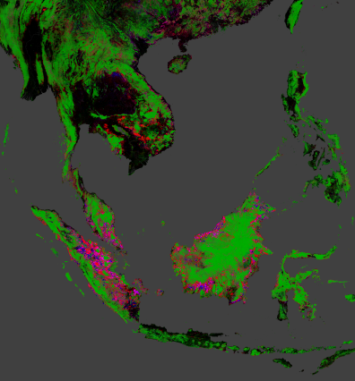
Human Influence and disturbance
Human Influence Index
Composite maps based on human population, infrastructure and transport
http://sedac.ciesin.columbia.edu/data/set/wildareas-v2-human-influence-index-geographic
GHSL - Global Human Settlement Layer – 1970-2014
http://ghsl.jrc.ec.europa.eu/
Global forest change 2000-2014
http://earthenginepartners.appspot.com/science-2013-global-forest/download_v1.2.html
Example: Forest cover change in South East Asia 2000-2014

Slide 5
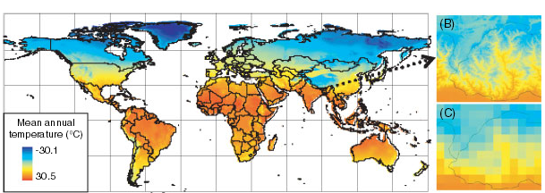
Climate
Worldclim – Past, current and future
http://www.worldclim.org
Hijmans, Robert J., et al. "Very high resolution interpolated climate surfaces for global land areas." International journal of climatology 25.15 (2005): 1965-1978.

Slide 6
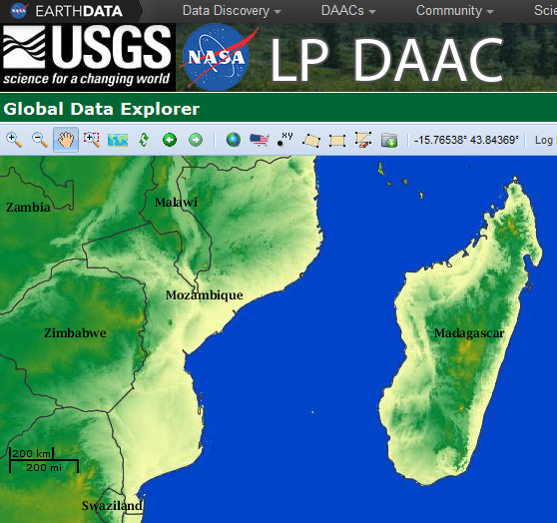
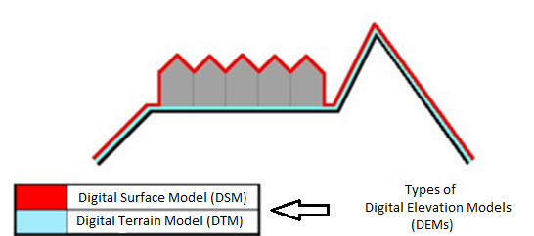
Elevation
Satellite data from ASTER or SRTM
http://gdex.cr.usgs.gov/gdex/
Beware the terminology!
Example: ASTER satellite DEM data

Slide 7
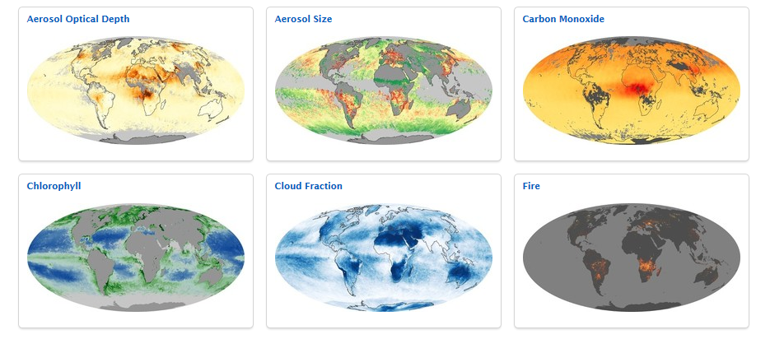
Satellite datasets
NASA (derived products) - www.earthobservatory.nasa.gov/GlobalMaps/

Slide 8
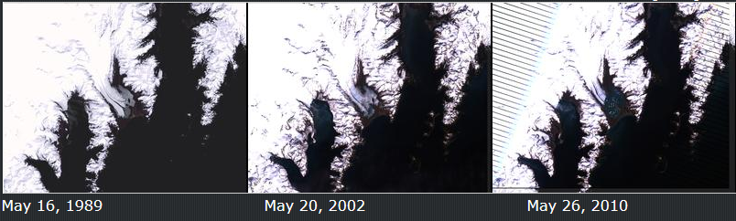
Satellite raw time-series imagery
Landsat represents the world's longest continuously acquired collection of space-based moderate-resolution land remote sensing data. - Landsat - https://landsat.usgs.gov/

Slide 9
Other useful links
For European datasets
http://www.eea.europa.eu/data-and-maps
Country level datasets
www.diva-gis.org/Data
For satellite data..
www.earthobservatory.nasa.gov/GlobalMaps/

